Slide 1

Vivekanand Education Society’s Institute Of Technology
Department Of Information Technology
DSA mini Project
A.Y. 2024-25
Sustainability Goal :Prevention of generation of green house emissions and healthier surroundings
Title: Carbon Foot print tracker
Domain:Sustainability and clean environment
Group Members:
Member1 :Nikhil Rajesh Kadam (21)
Member2 : Yash Bhurke(09)
Member3 :Ved Joshi(20)
Mentor Name:Prof. Kajal Joseph

Slide 2





Slide 3
Content
Introduction to the Project
Problem Statement
Objectives of the Project
Scope of the Project
Flow chart
Data Structure & Concepts Used
Algorithm Explanation
Front End
Gantt Chart
Implementation
Output Screenshots
Conclusion’
References(IEEE and Capgemini)

Slide 4
Introduction to Project
A carbon footprint calculator measures greenhouse gas emissions, primarily CO₂, from individual or organizational activities. It promotes environmental awareness by providing insights into daily habits, personalized recommendations for reducing emissions, and options for offsetting through renewable energy or reforestation investments, supporting sustainability efforts.
r Rates

Slide 5
Problem Statement
r Rates
Individuals and organizations struggle to accurately measure carbon emissions due to complex, time-consuming methods that are prone to errors. This leads to ineffective management of greenhouse gas emissions, hindering efforts to promote sustainability and combat climate change.

Slide 6
Objectives of the project
Calculate Carbon Footprint: The primary objective is to compute the carbon footprint for different sources, including buildings, cars, and bicycles.
User Interaction: It allows users to input various CO2 sources and their quantities, enhancing engagement and customization.
Display CO2 Sources: After calculations, the program displays the CO2 sources along with their respective quantities and factors.
r Rates

Slide 7
Scope of the project
Enhanced User Interface: Develop a user-friendly GUI with interactive graphs and charts for better data visualization
.Mobile Application: Create iOS and Android versions with sensor integration for accurate data collection.
Expanded Database: Include more CO2 sources and regularly update emission factors.
Machine Learning Integration: Develop predictive models and personalized suggestions based on user habits.
IoT Integration: Connect with smart devices to gather real-time energy consumption and travel emissions data.
AI implementation: The integration of Artificial Intelligence and the implementation of Machine Learning can help us to calculate the carbon footprint more precisely and also suggest the users personalized measures

Slide 8
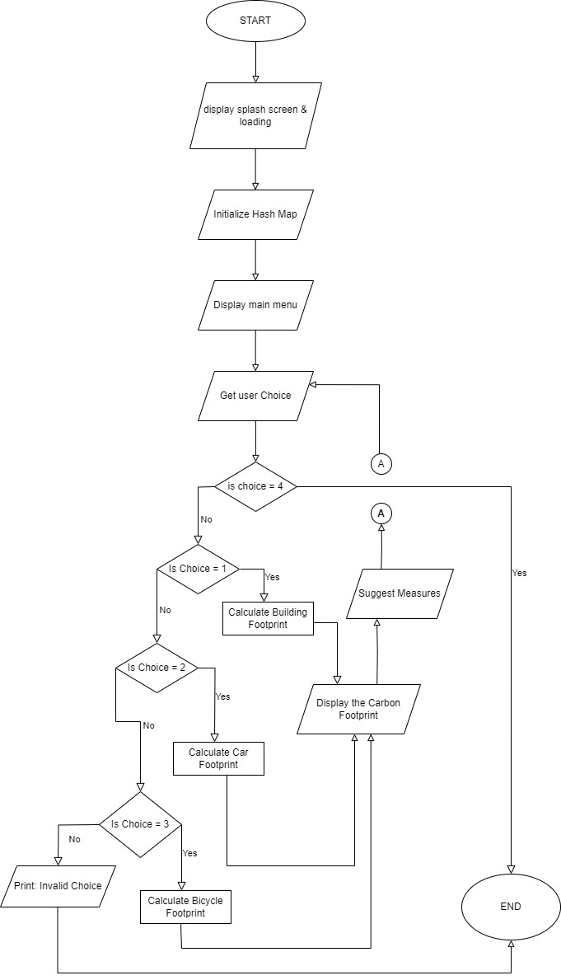
ER diagram of the proposed system
Flowchart:-

Slide 9
Data structures and concepts used
The carbon footprint calculator code utilizes the following data structures and concepts:
1) Data Structures
- Structs:
- Co2Source: Represents CO2 sources with attributes for name, CO2 factor, quantity, and pointers for binary tree structure.
- HashMapEntry: Represents entries in a hash map for storing CO2 factors, including the name and a pointer to handle collisions.
- Array:
- Hash Map: An array of pointers to `HashMapEntry`, used for efficient storage and retrieval of CO2 factors.
Concepts
- Hashing: A hash function converts source names into indices for the hash map, enabling quick access to CO2 factors.
- Binary Tree: The `Co2Source` struct organizes CO2 sources in a binary tree for efficient insertion and traversal.
- Dynamic Memory Allocation: Uses `malloc` to allocate memory for new entries in the hash map and binary tree.
- Recursion: Functions like `calculateCarbonFootprint` and `displayCo2Sources` use recursion for tree traversal.
- User Input Handling: Captures user-defined CO2 sources and quantities for dynamic calculations.
These structures and concepts work together to create an efficient tool for calculating and displaying carbon footprints.

Slide 10
Algorithm Explaination
The algorithm for the carbon footprint calculator follows these steps:
Initialization: Set up a hash map for CO2 factors and a binary tree for CO2 sources. Display a splash screen with a loading animation.
User Input: Present a menu for users to select the type of carbon footprint calculation (building, car, bicycle). Gather input for CO2 sources and quantities.
Data Storage: Use the hash map to store CO2 factors and insert sources into the binary tree using recursive functions.
Calculation: Recursively calculate total carbon footprints by traversing the binary tree.
Display Results: Show CO2 sources, total footprint, and suggest measures to reduce emissions based on the calculated footprint.
Exit: Allow users to exit the program gracefully.

Slide 11
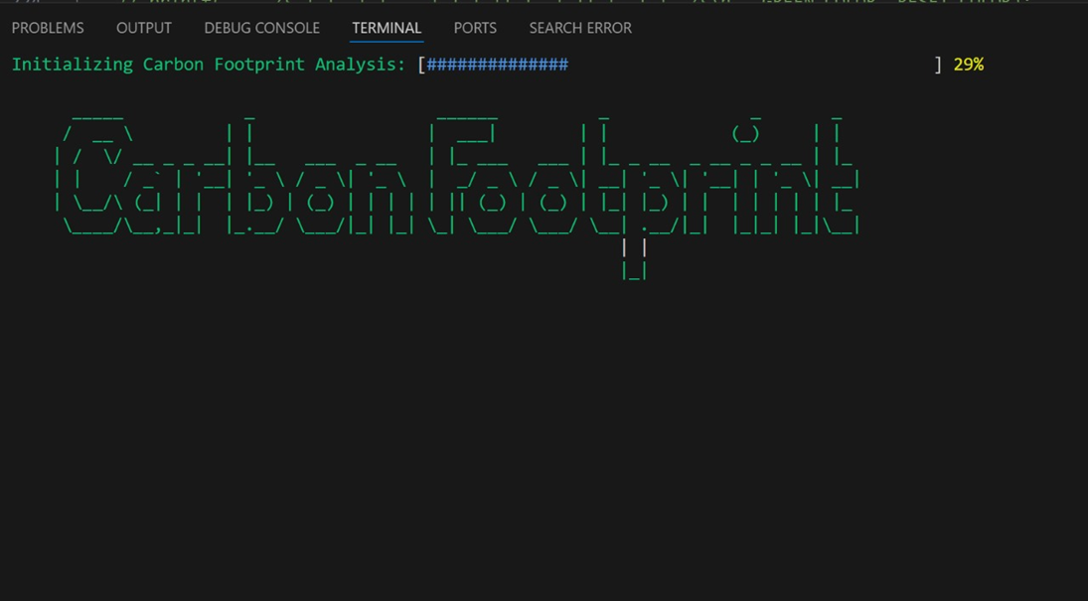
Front End

Slide 12
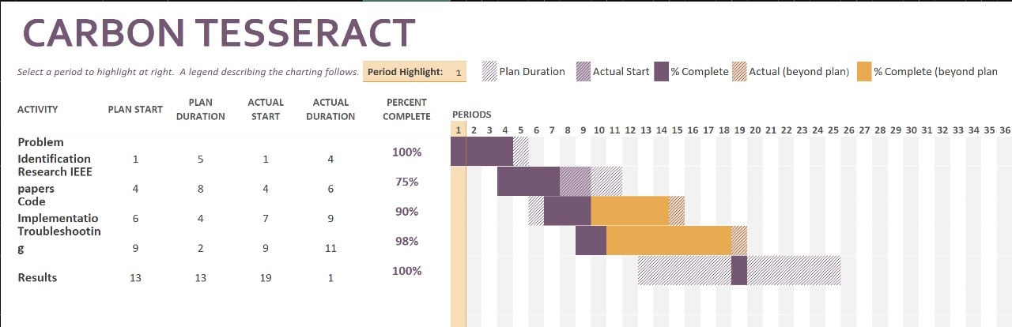
Gantt Chart

Slide 13
Implementation
Utilizes a binary tree (`Co2Source`) to store and organize CO2 sources for efficient insertion and retrieval.
Employs a hash map for quick access to CO2 factors, enhancing data management and retrieval efficiency.
The `createCo2Source()` function initializes new CO2 source nodes with relevant attributes.
The `insertCo2Source()` function inserts CO2 sources into the binary tree based on their calculated values.
Functions like `calculateCarbonFootprint()` and `displayCo2Sources()` recursively compute and display total carbon footprints from the binary tree.

Slide 14
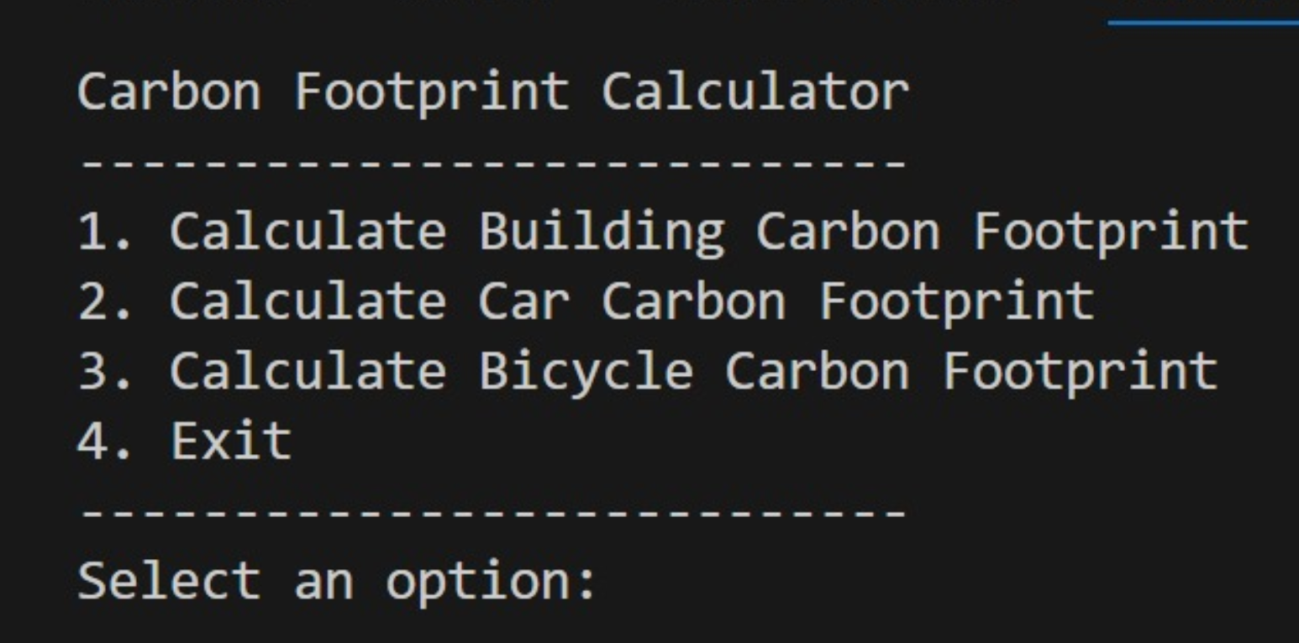
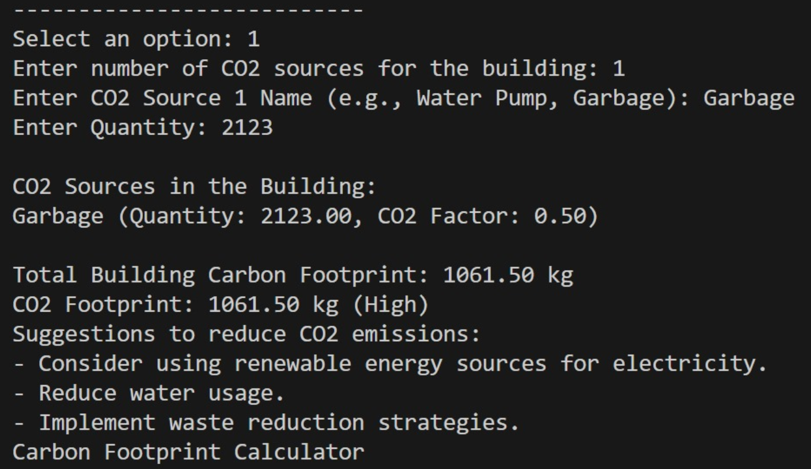
Output Screenshots

Slide 15
Conclusion
The Carbon Footprint Calculator mini-project effectively integrates data structures and algorithms in C to address the pressing issue of environmental impact. Through this project, we demonstrated the ability to design an efficient, user-friendly program that calculates carbon footprints and offers practical insights for reducing emissions. This project not only solidified our technical skills but also highlighted the critical role technology plays in promoting environmental sustainability. Moving forward, the knowledge and experience gained will serve as a foundation for developing more advanced and impactful solutions to global challenges.

Slide 16
References
Capgemini initiative:-
Capgemini's 2021 Carbon Reduction Plan outlines its commitment to achieving carbon neutrality by 2025 and becoming a net-zero business by 2030.
The baseline year for emissions reporting is 2019, with a significant portion of emissions coming from business travel and office operations.
Key targets include reducing Scope 1 and 2 emissions by 75% by 2025, using 100% renewable electricity by 2025, and reducing business travel emissions
by 38%. The company has implemented several initiatives, including transitioning offices to renewable energy, increasing energy efficiency, and adopting
virtual collaboration to reduce travel. Capgemini acknowledges the temporary impact of COVID-19 on emissions reductions but is committed to long-term
sustainability goals through ongoing projects like electric vehicle adoption, flexible working, and global tree-planting efforts.Challenges remain in
addressing Scope 3 emissions, especially business travel and employee commuting.
Measuring AI’s Carbon footprint:-
As AI models grow exponentially, their carbon footprint becomes a pressing concern.
Recent research introduces more accurate measurement methods, focusing on GPU energy consumption and local emissions data.Geographical location
significantly impacts emissions, with CO2 per kWh varying widely across regions. Techniques like flexible start times and pausing during high-emission
periods can reduce the carbon footprint, especially for smaller models. The largest models emit as much carbon as powering a U.S. home for a year.
Transparent reporting is crucial for developing more environmentally friendly AI technologies and informing decision-making in model training and
deployment.

